Slide 1
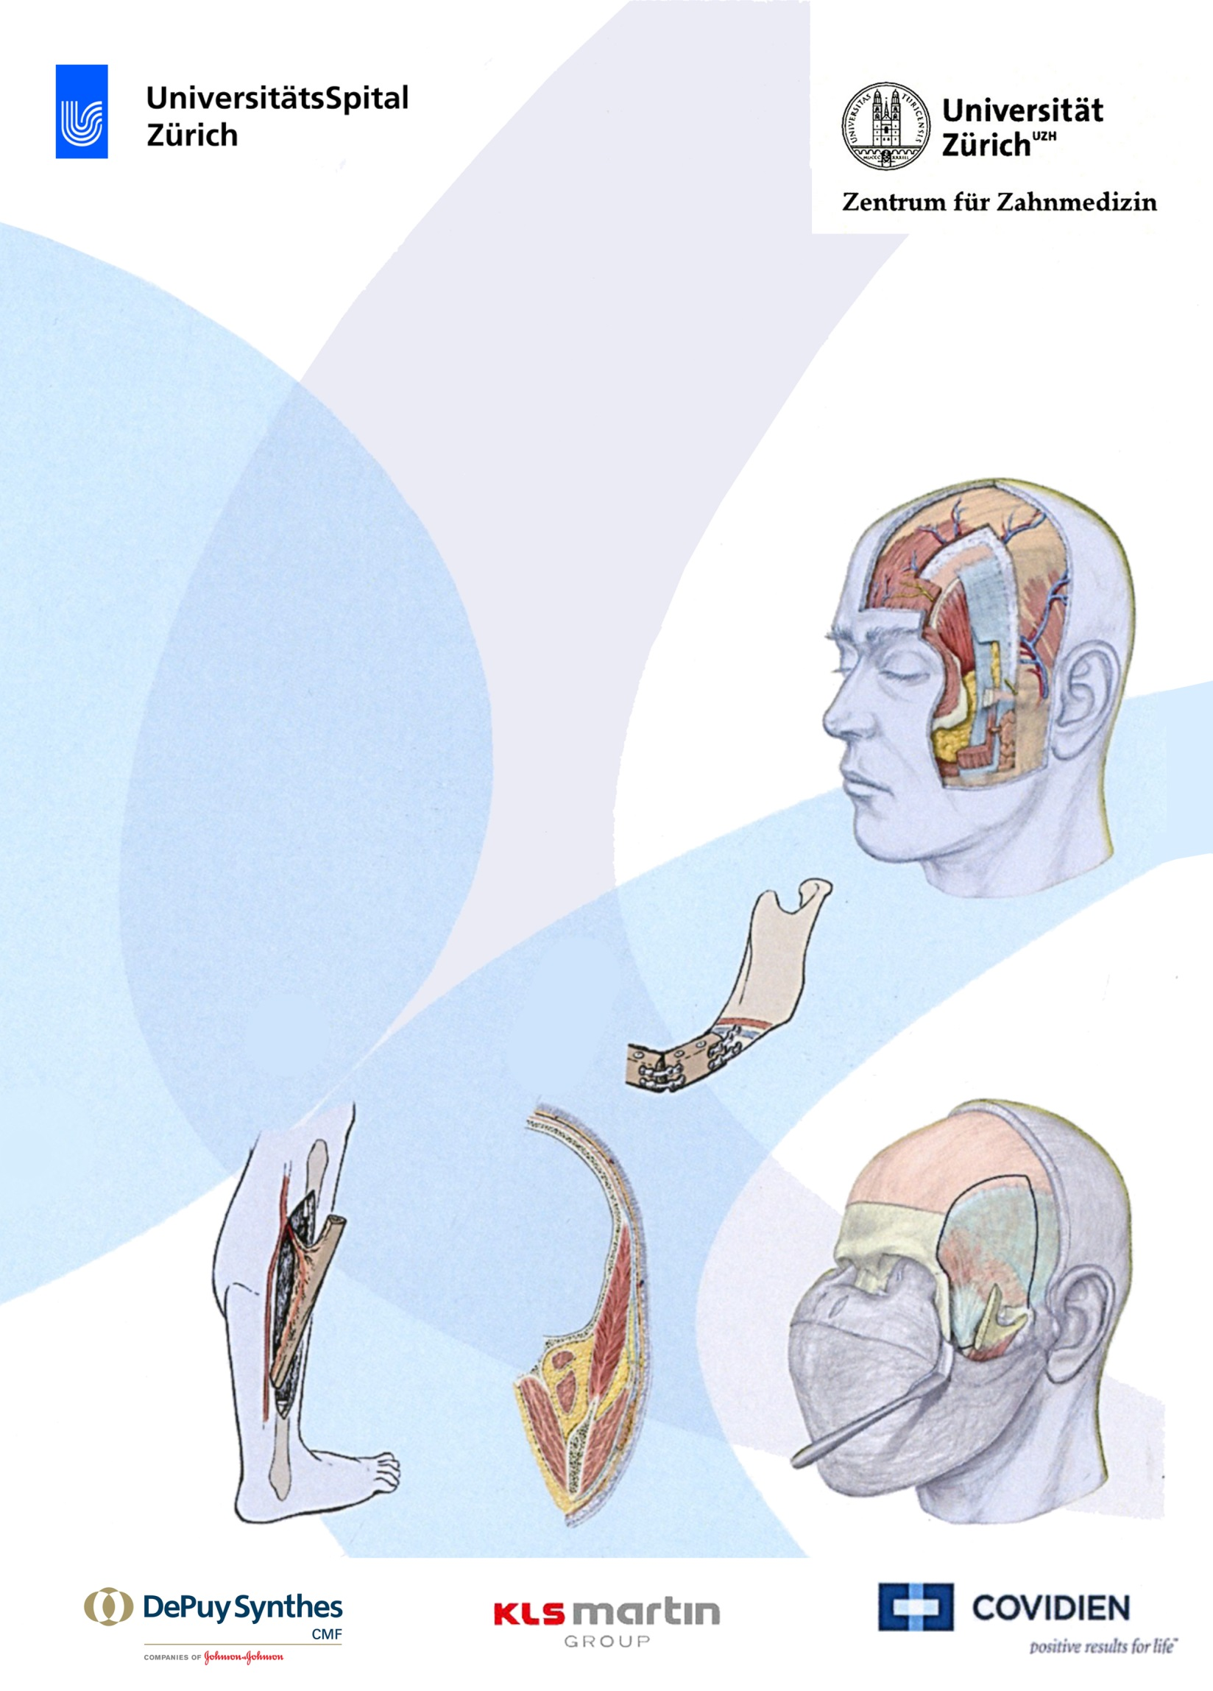
11th Surgical Facial Access
and Flap Course, Zürich
June, 16th- 18th 2016
Klinik für Mund-, Kiefer- und Gesichtschirurgie
UniversitätsSpital Zürich
Head:
Prof. Dr. Dr. med. M. Rücker
Anatomisches Institut
Universität Zürich
Head of Division Gross Anatomy:
Prof. Dr. Dr. med. O. Ullrich
Course Chairman:
Marius Bredell
BChD, MBChB, MChD, EBOMFS

Slide 2
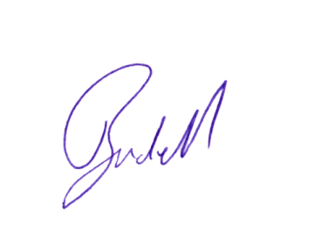
Description of course
Dear Colleague
We would like to invite you to this, the 11th Surgical facial access and Flap course in the beautiful city of Zürich,
The course has in mind to assist surgeons working in the head and neck region in their daily work in a very practical way . The platform of well preserved wet cadavers (prepared in a way that makes dissection more life-like) will give all the participants the opportunity to review the practical surgical anatomy and perform a wide variety of procedures themselves in a less stressed and critical environment.
Participants will participate in either the Facial Access or Free Flap course according to their wish as indicated on their registration form, later changes may not be possible. Additionally we offer a digital fibula flap planning course the morning before.
Lectures on surgical anatomy and approaches will be held together, but each participant will then either do the Facial Access or Free Flap practical. In this way there often is significant and interesting cross interaction between colleagues, leading to fruitful discussions.
Participants will work in groups of two each and will be able to perform the procedures themselves. Surgical instruments will be provided.
Pre-reading of relevant anatomy and techniques is strongly recommended. Participants are advised to bring their own anatomy textbooks along.
Limited free dissection may be performed.
We hope to see you in Zürich soon
Yours sincerely
Marius Bredell (Course Chairman)

Slide 3
Faculty: Experienced Head and Neck and Reconstructive Surgeons
Provisional course programme:
16 June 2016
18 June 2016
Lecture
Practical
Lecture
Practical
Lecture
Practical
Lecture
Practical
17h00
Neck access and Supraomohyoid Neck dissection as well as Fibula free flap.
Neck access and Supraomohyoid Neck dissection (left side) Fibula Freeflap.
Tracheostomy and condylar Plating via Intraoral route, Condy‑lar access via Submandibular, Transparotid, Retromandibular access as well as Pectoralis Myocutaneous flap.
Tracheotomy and Plating of Condyle through Intraoral route, Submandibular, Transparotid, Retromandibular access. Pectoralis Major Flap.
Temporalis flap as well as Latisimus dorsi Free flap.
Temporalis Flap, Latissimus Dorsi Free flap Dissection (Cadaver rotated to side)
Local skin Flaps, Medial femur condyle Flap.
Local skin flaps, Medial femur condyle flap
Cocktail and Closure
09:30
13:30
Lecture
Practical
Lecture
08h15
Practical
Lecture
Practical
Lecture
Practical
Hands on Computer based Fibula Planning
Synthes Pro Plan CMF
Introduction and Organisation
Orbital Access as well as Radial Forearm Free flap.
Orbital access. Radial Forearm Flap
Temporomandibular joint access and Le Clerq, as well as Upper lateral thigh flap.
Temporomandibular Joint exploration and Le Clerq procedure. Upper Lateral Thigh Flap.
Gillies Elevation, Zygoma hook and Positioning screw placement, as well as Coronal approach, as well as the DCIA Flap.
Gillies elevation, Zygoma hook, Coronal Approach to Zygoma and Nasal structures. DCIA Flap.
Parotid and Facial nerve and Rectus abdominis free flap.
Approach to the Parotid and Facial Nerve (Left side only) Rectus Abdominis Freeflap.
Course Dinner
17 June 2016

Slide 4
Chair and Organisation
Course Chairman and Organizer
Marius Bredell BChD,MBChB, MChD, EBOMFS
Senior Consultant Department of Oral and
Cranio-Maxillofacial Surgery
University Hospital Zurich
Frauenklinikstrasse 24
CH-8091 Zürich
Phone +41 44 255 90 56
Fax +41 44 255 41 79
E-Mail marius.bredell@usz.ch
Course Faculty
Local faculty
(To be announced)
International Faculty
Mr Massimo Maranzano MD, DDS
Oral and Maxillofacial Surgeon
Cct Plastic and Reconstructive surgery
Consultant Maxillo-Facial Surgeon (with subspeciality interest in Head & Neck Oncology and Microvascular Facial Plastic Reconstructive Surgery)
Manchester Royal Infirmary, Division of Surgery
Manchester Head and Neck Centre Edale House - 1st Floor, Oxford Road
Manchester, M13 9WL
General Information and Registration
Date
June 16th -18th 2016
Course Fee
CHF 1250.-
Course fee including
Lunches, coffee
and course dinner
Course Concept
Lecture and Hands-on
Practical
Synthes Computer Based
Planning Module
Provisional: CHF 400
Location
Department of Anatomy,
University of Zürich
Anatomisches Institut
(Universität Zürich-lrchel)
Winterthurstrasse 190
CH-8057 Zürich
Building 42
Seminar Room G 53
Course Language
English
Congress Registration
To register please request
registration form and send to
Fax+41 44 255 8989
E-Mail jana.tallarico@usz.ch
Course Secretary
Mrs Tallarico Department of Oral and Cranio-Maxillofacial Surgery University Hospital Zurich Frauenklinikstrasse 24
CH-8091 Zürich
Phone +41 44 255 50 31
Fax +41 44 255 89 89
E-Mail jana.tallarico@usz.ch
For further Information please
contact:
marius.bredell@usz.ch
You will receive a confirmation
per E-Mail.
Attention!
The number of participants is limited.

